Slide 1
HOW TO CHANGE YOUR ADMIN PASSWORD
You forgot the password
You never knew the password

Slide 2
HOW TO CHANGE YOUR ADMIN PASSWORD
Boot into recovery mode
  If you do not see GRUB menu during a normal boot, hold down the shift key during boot up

Slide 3
HOW TO CHANGE YOUR ADMIN PASSWORD
Select recovery mode (usually the 2nd entry)
Press enter

Slide 4
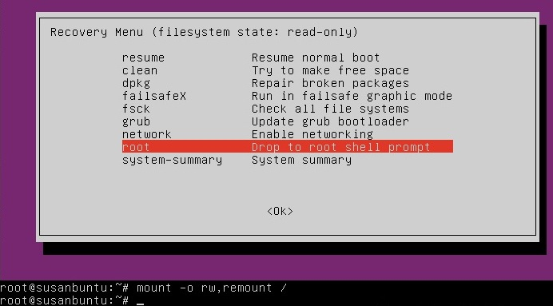
HOW TO CHANGE YOUR ADMIN PASSWORD

Slide 5
HOW TO CHANGE YOUR ADMIN PASSWORD
The filesystem may be mounted as read-only, so you need to enter the follow command to get it to remount as read-write, which will allow you to make changes:
mount -o rw,remount /
Remember you are in the root account so be careful

Slide 6
HOW TO CHANGE YOUR ADMIN PASSWORD
If you have forgotten your user name as well
ls /home will give you a list of users
Type passwd username replacing user name with your name
You'll then be prompted for a new password
Just type the password and hit Enter when you're done
You'll be prompted to retype the password. Do so and hit Enter again
Type exit

Slide 7
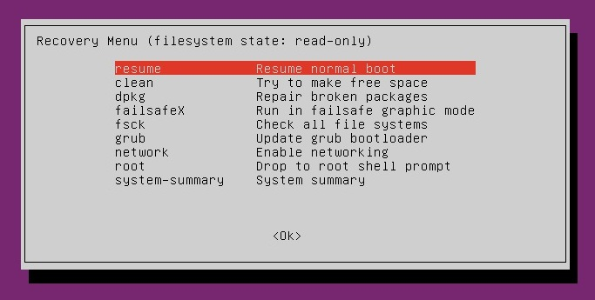
HOW TO CHANGE YOUR ADMIN PASSWORD

Slide 8
HOW TO CHANGE YOUR ADMIN PASSWORD
NOW YOU KNOW YOUR PASSWORD!!!

Slide 9
HOW TO CHANGE YOUR ADMIN PASSWORD
For an easy step by step how to see
www.psychocats.net/ubuntu/resetpassword

